Slide 1
Open Source Container Security:
A Brief Overview
Jessica Repka| DevOps Engineer | LexisNexis

Slide 2
Security Basics
The most common priorities are Vulnerabilities and Compliance.
In short, how you can be hacked into and rules on how not to get hacked into.
Prevention is key.

Slide 3
PRevention what does that mean?
Prevention means protection from start to finish of your images, containers files and pipelines.
It means scanning everything you make and use to make sure nothing is open enough to be used by a bad actor.

Slide 4

Compliance
Policies
White and black listing rules of what is acceptable for deployment into production.
Runtime watching
Watching activity in your container environment, if someone is executing a command you don’t expect you get notified.
Forensics
Post mordium actions to reverse engineer what happened that caused a breach.

Slide 5

Vulnerabilities
CVE’s
Known lists of exploits by the security community
Operating system packages
Can have exploits, if not often updated leaves an open window for hackers
Application files
If passwords are left in the open in plain text can allow for full control of the application

Slide 6
What Am I Preventing?
Theft of your Proprietary applications and code

Slide 7
Containers
Docker
Rktlet
Kubernetes
Storage
Applications
Scaling

Slide 8
Anchore Engine
Falco
Sysdig
Open Source Tools:
All Deployable through Helm and docker!

Slide 9
These Tools Work Together!
Each application has its own function but link together for large scale security

Slide 10

Anchore Engine
Image Library
Anchore has the ability to submit an image to be analyzed and kept in a personal library
CVE and File Tracking
Analyzed(Scanned) images can provide a list of known CVE Vulnerabilities and List Files in the Image
Policy Control
Policies can be customized to your needs. You can choose white and black list items

Slide 11
Anchore: Pros and Cons
Fast deployment, quick configuration.
You can only have one policy active at a time, which can lead to large policies that are hard to control.

Slide 12

Falco
Image Deployment Prevention
Scanning and policy is used to prevent failed image deployments. (Falco says No!)
Rule Sets with Conditions
You can set your own runtime rules in Falco in minutes to take action.
This includes warnings to teams, or stopping the container.
Visibility
Falco monitors actions in the containers and allows for the logs to be shown real time

Slide 13
Falco: Pros and Cons
Deployment prevention in place for untrusted or unsecure images.
Configurable alerting based on activity rules you can customize.
Rules have race conditions if you have too many in place.

Slide 14

Sysdig Inspect
Falco Rule integration
Falco action rules created can use sysdig to trigger gathering data for future forensics
Front end for Live Events
When the inspect container is created and running a front end is immediately available
Drill down the Details
The front end provides an easy to navigate drill down for what is happening everywhere

Slide 15
Sysdig Inspect: Pros and Cons
Capture logs and send them to separate storage for forensic purposes. Front end visual for live streaming.
Actions rules in falco, can create a capture rule, however if you set up a rule to delete the pod you lose the logs before you can gather them.

Slide 16
Well that is cool
Oh yea it is, but let’s talk about Jenkins and Kubernetes and Security integration

Slide 17
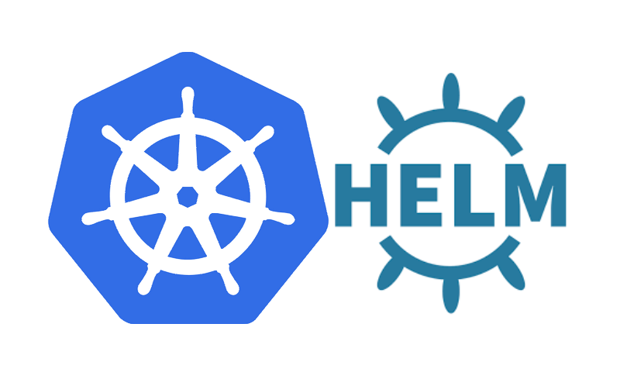
Kubernetes Integration in a jiff
Each of these tools can be deployed into your cluster via helm charts.
Overhead is minimum, and once configured will watch your cluster from the inside and prevent bad applications from being deployed into the cluster.

Slide 18

Jenkins Integration: because CICD is amazing
Using Jenkins for continuous integration is pretty common.
Integrating this security set up is as easy as installing a plugin, because all you have to do is install the Anchore Engine plugin and configure it to communicate with your Anchore engine container in the cluster.

Slide 19
In any company
Security can start
With you

Slide 20
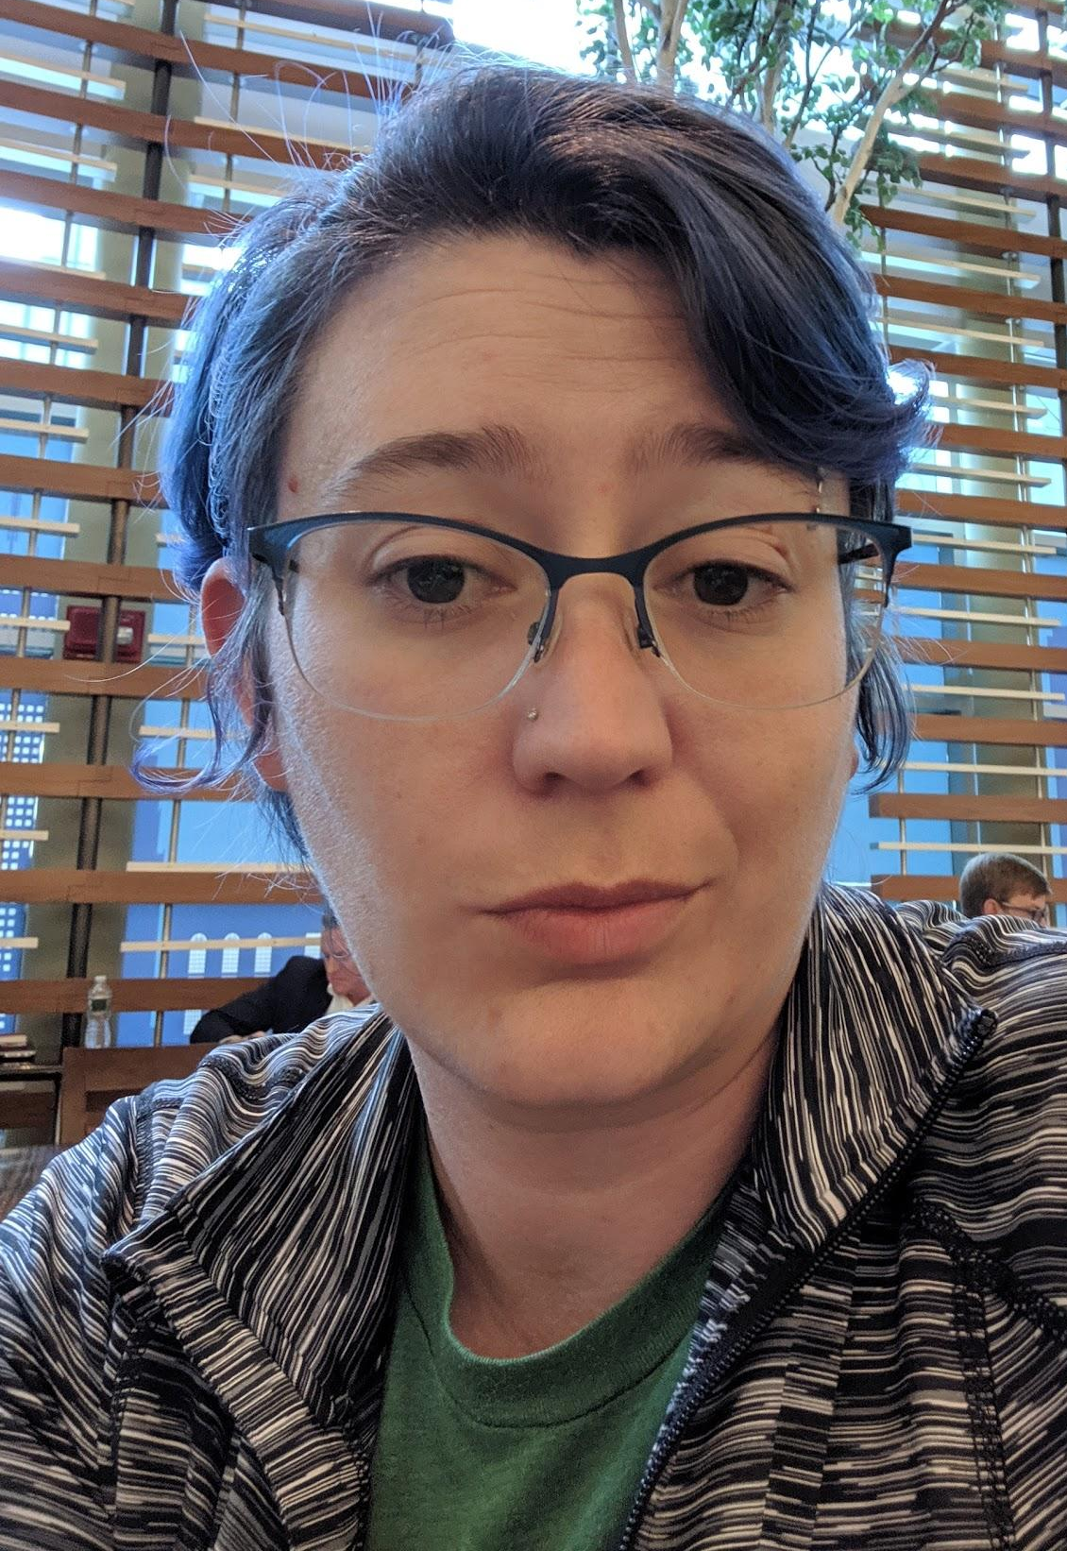
Open Source Container Security:
A Brief Overview
Jessica Repka
Email: jessrepka@gmail.com
Twitter: @AlyndertheRed1
Checkout my articles on Opensource.com

